Slide 1
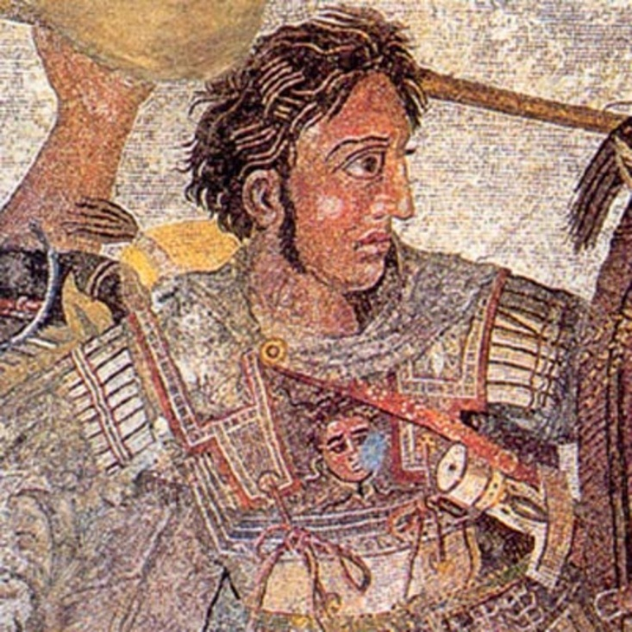
Alexander the Great: Facts and Cultural Contributions
Mrs. McSweeny

Slide 2
Hellenistic
The Hellenistic World ("Hellenistic" from the Greek word Hellas for Greece) is the known world after the conquests of Alexander the Great.
Alexander’s tutor was the Greek philosopher Aristotle 384-322 BCE) and, as Alexander traveled, he spread Greek thought and culture, thus "hellenizing" (to make `Greek’ in culture and civilization) those he conquered.

Slide 3
Story of the Philosopher
According to legend, while still a prince in Greece, Alexander sought out the famed Diogenes the Cynic, who rejected social niceties (comforts) and slept in a large clay jar. Alexander approached the thinker in a public plaza, asking Diogenes if there was anything he in his great riches could do for him. “Yes,” Diogenes replied, “stand aside; you’re blocking my sun.” Alexander was charmed by Diogenes’ refusal to be impressed, stating, “If I were not Alexander, I would be Diogenes.”
What do you think this shows about Alexander’s character?

Slide 4
Alexander as Military Leader
Alexander was only twenty years old when he became king.
In his day, troop movements were primarily on foot, and communications were face to face. From his first victory at age 18, Alexander gained a reputation of leading his men to battle with impressive speed, allowing smaller forces to reach and break the enemy lines before his foes were ready. After securing his kingdom in Greece, in 334 B.C. Alexander crossed into Asia (present-day Turkey) where he won a series of battles with the Persians under Darius III.
In 15 years of conquest Alexander never lost a battle.
What does this say about Alexander’s ability as a military leader?

Slide 5
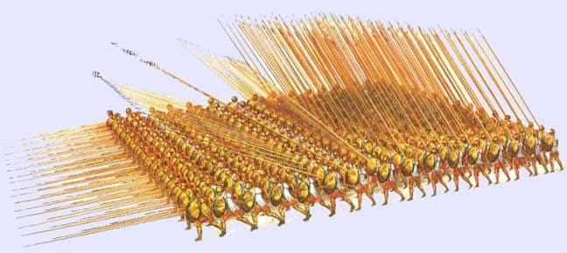
The Phalanx
The centerpiece of Alexander’s fighting force was the 15,000-strong Macedonian phalanx, whose units held off the sword-wielding Persians with 20-foot-long pikes called sarissa.

Slide 6
Alexandria(s)
Alexander encouraged Hellenization by founding at least 70 new cities throughout his empire and populating them with Greeks.
Some cities named after Alexander the Great are Alexandria in Egypt, Kandahar in Afghanistan and Iskandariya in Iraq.
After conquering an area, Alexander would build a fortress, garrison it with troops and often name it after himself, so such cities exist or existed across the Middle East and Central Asia.
Why do you think Alexander built a fortress in his new cities? What does this say about Alexander’s ability as a emperor?

Slide 7
The Destruction of Persepolis
Alexander the Great wanted to continue his father’s mission of revenge against the Persians.
Alexander destroyed Persepolis after Persian ruler Xerxes burned the Acropolis. Additionally, Alexander took issue with the teachings of the Zoroastrian religion, and destroyed numerous Zoroastrian properties, including monuments and iconic figures, in many areas of the Persian empire.
What does this destruction of the city of Persepolis show us about Alexander’s personality?

Slide 8
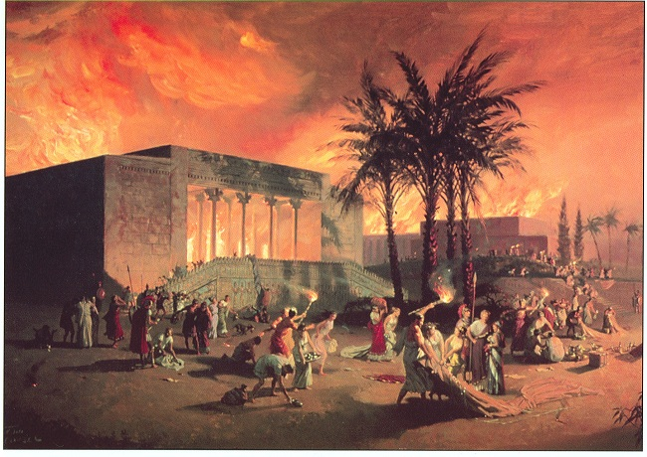
The Persian capital of Persepolis is sacked and burned by Alexander's army. Items stolen by Xerxes in the Persian War were returned to Athens. Was this payback for the burning of Athens by Xerxes one-hundred fifty years earlier?

Slide 9
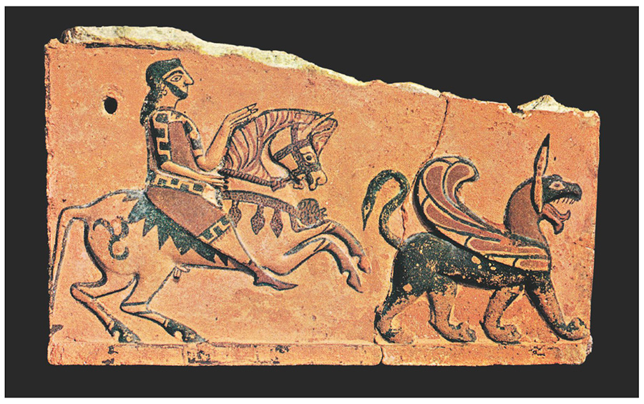
After defeating the Persians, Alexander started dressing like them.
Alexander began to wear the striped tunic, girdle and diadem of Persian royal dress—to the dismay of cultural purists back in Macedonia.
In 324 he held a mass wedding in the Persian city of Susa, in which he forced 92 leading Macedonians to take Persian wives (Alexander himself married two, Stateira and Parysatis).
Why do you think Alexander began to wear Persian clothes and marry Persian women?

Slide 10
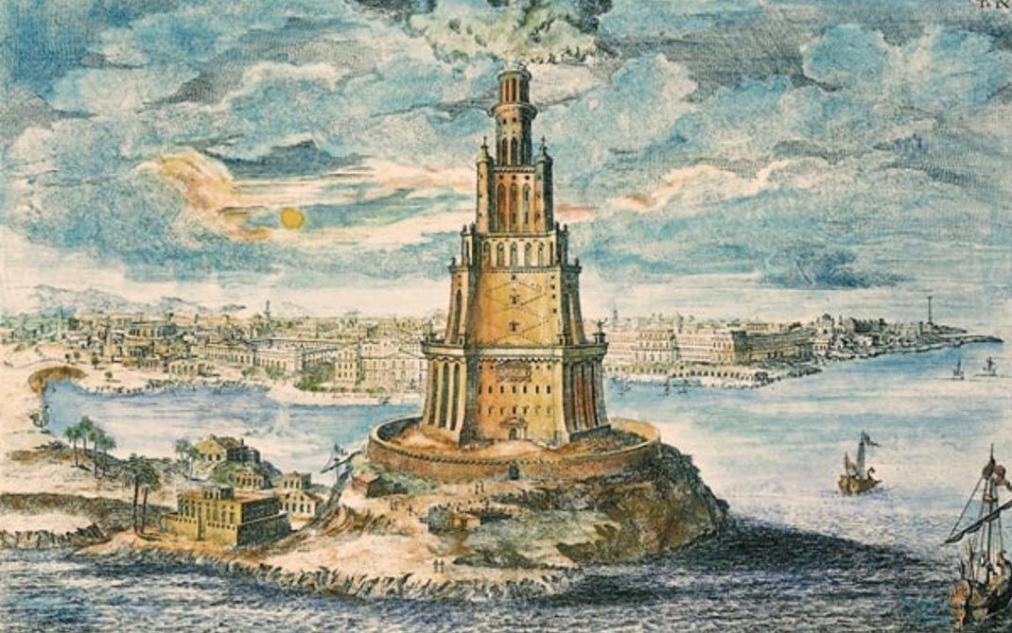
Alexandria, Egypt
While fighting the Persians, Alexander conquered Egypt and founded a city at the mouth of the Nile River. This city, which he named Alexandria after himself, became a cosmopolitan, diverse, bustling center of trade, the arts, and ideas. It was second only to Rome in size and wealth.

Slide 11
The Library of Alexandria
The idea of a universal library, like that of Alexandria, arose only after the Greek mind had begun to imagine and take on a larger worldview.
The Greeks were impressed by the achievements of their neighbors, and many Greek intellectuals sought to explore the resources of all knowledge.
Alexander’s campaigns resulted in a “considerable addition of empirical knowledge of geography,” as Eratosthenes remarked (as reported by Greek geographer Strabo).

Slide 12
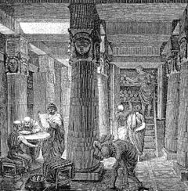
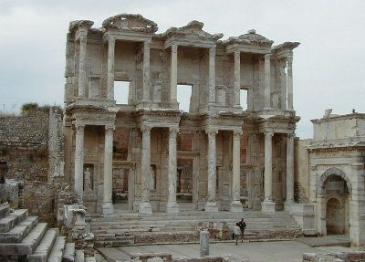
Library of Alexandria
Although this library was built after Alexander, how does it serve as a legacy of his?

Slide 13
His End
Alexander continued his campaign, driving farther east, until he reached India and the Indus River in 326 B.C.E. At this point, his exhausted troops refused to fight further. They told Alexander that a truly great leader knows when it is time to stop fighting.
Without the support of his army, Alexander had no choice but to turn back and begin consolidating and organizing his far-flung empire.
In 323 BC, while in Babylon, Alexander got very sick with a fever and died. He had no plans for a successor to his empire, and his infant son was too young to rule. As his generals gathered around their dying king, they asked him whom he would leave his empire to, Alexander replied, "To the strongest!“
If these really are Alexander’s last words, what is your opinion of them? Explain.
Do you think Alexander would have taken over more lands if his troops had not stopped? Why or why not?

